Slide 1
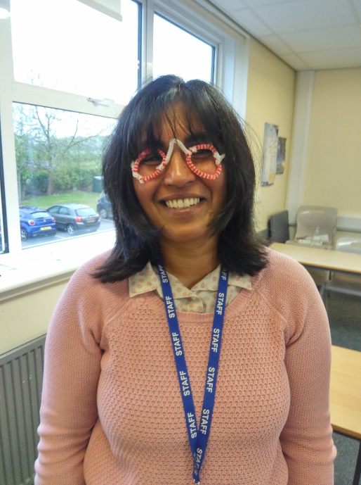
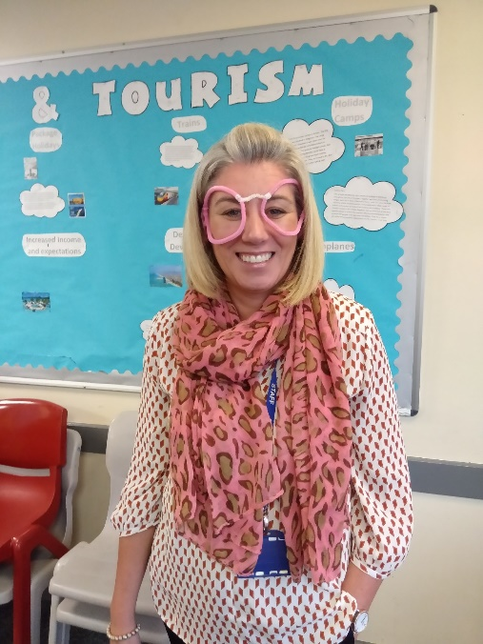
Hi everybody,
Thank you so much to those parents that have been posting photos of what your children have been getting up to online. Mrs Waters and I have thoroughly enjoyed seeing the pictures and posting replies.
This term we have been trying to concentrate on the basics for early years because our year is about laying the foundations of learning for years to come.
To that end a little and often is better than over loading your child. We have focused this week on the tricky word me, the new trigraph ure and reinforcing the sound th. We will also be exploring 1 less and subtraction. So please pick activities from those that are posted online and aim to do two phonics and two maths activities. Again we would love to see your work on virtual@beaudesert.school
The science activity for this week will be posted separately on the website.
Please don’t forget that it will be VE day on Friday 8th May and there will be some activity ideas for your children to pick from on the website as well.
Have a super week and we look forward to
more of you posting your work online
Much love
Mrs Ramm & Mrs Waters.

Slide 2
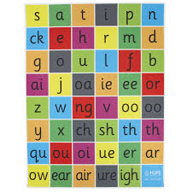
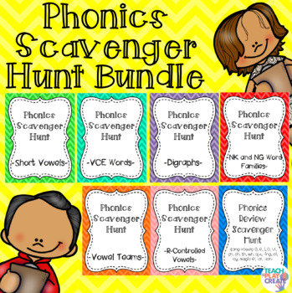
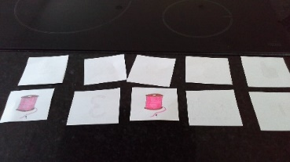
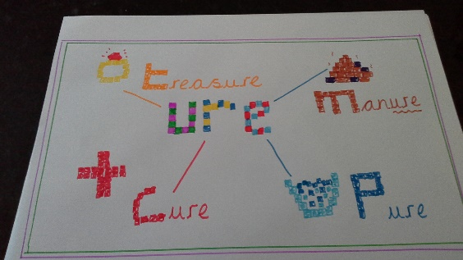
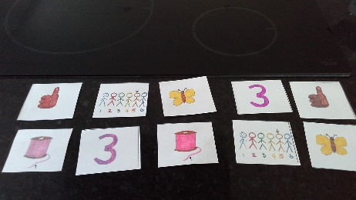
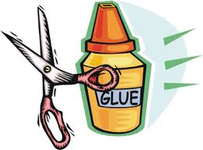
Art
Design a poster with the sounds ure/th and illustrate with words that begin with or have these sounds in them. You can do this using the computer, felt tips, collage etc
Create an A4 montage of you and the things that you have been getting up to. You can do this using printed photographs, use the computer or draw the pictures yourself.
Challenge yourself to write the sentence ‘this is me’ using your word and sound mat to go with your montage.
Investigate making some words using the word wheels (see attached cut and stick sheet) and see how many words you can make
https://www.youtube.com/watch?v=ob7bOrRtX3Q – this you tube website will reinforce all sounds and tricky words and help you say the ‘ure’ sound correctly
https://www.phonicsbloom.com/uk/game/yes-no-yeti?phase=3 – great game to practice reading
https://www.phonicsbloom.com/uk/game/alien-escape?phase=3 – great game for some spelling practice
Treasure Hunt
these can be played indoors and /or outdoors
Construct a treasure hunt game by printing the attachment and hiding the words (blue words). Children find as many as they can Each time they find one they have to say the word to score a point. Score a certain number to obtain a treat or receive a certificate off us. Let us know on virtual@beaudesert.
Vary the game using phase 3 sounds – attachment included or
have 6 or so pieces of paper with just the ure sound or the th sound on them. These can then be hidden.
Or you could hide words that begin with or have these sounds in them. You may have to limit the number of words to six words.
Week beginning – 4th – 8th May
This week in Phonics – this week we are introducing the sounds ure, reinforcing the sound th & introducing the tricky word me.
Design and make
Create your own pairs games using the sounds ure and th. You could match written word to written word or picture to picture of the words that begin with or have the above sounds in them.
Cut and stick activities
Explore the cut and stick activities attached to this powerpoint.

Slide 3
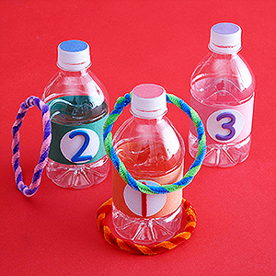
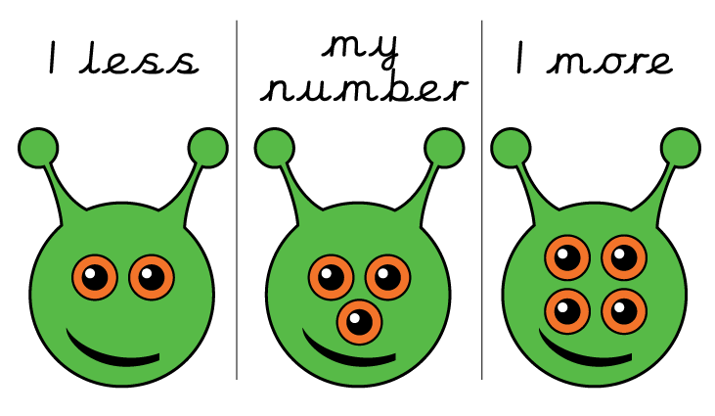
Design
Can you design and make your own board game involving either 1 less or subtraction?
Art Divide a piece of A4 paper into thirds. In the first column write ‘1 less’, in the middle column write ‘my number’ and in the last column write ‘1 more’. Choose your favourite number from 1-10 or 11 – 20. Using your favourite number either paint, draw or stick a picture to illustrate your number. Can you do the same picture on either side to illustrate 1 more and 1 less?
Outdoors - can you make your own ‘1 less’ hoopla game using items that you have at home for the skittles, e.g. tin cans, toilet roll tubes, plastic bottles. Attach 1 number from 1 – 10 on each bottle. Make yourself a set of hoops using cardboard. On each hoop write a different subtraction sum. For example
10 - 1 , 5 - 1, etc. Can you find the answer to your sum on your skittles and throw the hoop onto it?
4th – 8th May
Maths activities
Illustrate - how many different ways you can make your favourite number using subtraction? Choose a number from 1-10 or 11-20.
ICT – play 1 less and subtraction activities on Topmarks.co.uk
‘chopper squad’ , ‘minus mission’, ‘addition and subtraction ladder’.

Slide 4
Cut and stick the correct word for the blank part of the sentence. There are three sheets and they will get progressively more challenging.
nap
A tin .
An in an egg cup.
Pack a
Dad has a
bag
egg
can

Slide 5
Cut and stick the correct word for the blank part of the sentence.
join
A can be fat or thin.
Natasha sang a
Janika and her sister will us later.
I like to run in the .
moth
song
park

Slide 6
Cut and stick the correct word for the blank part of the sentence
secure
The vet has a for the cow.
The box is now
“Where is my ?”, thundered the pirate.
The has a strong smell.
treasure
manure
cure

